Slide 1
Population Ageing, the Structure of Financial Markets and Policy Implications W Todd Groome, Nicolas Blancher, Parmeshwar Ramlogan and Oksana Khadarina (2006)
Louise Delfosse
Victoria Schmidt-Scharff
2017-2018

Slide 2
Presentation
Introduction
Financial challenges of population ageing
Current efforts to address the challenges
The role of financial markets
The government as risk manager
Conclusion

Slide 3
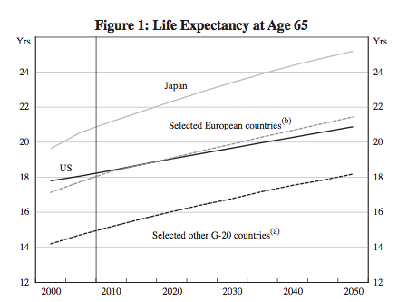
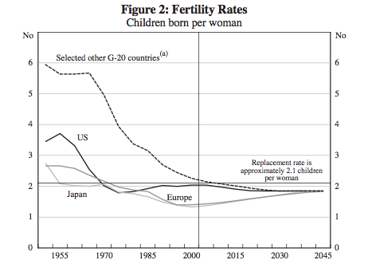
Introduction
Increasing life expectancy Continuing increase in the old-age dependency ratio
Decreasing fertility rates
OECD Countries - Old-age dependency ratio

Slide 4
Introduction
Pillar 1
State-provided pensions
Pillar 3
Private saving plans
Pillar 2
Occupational pensions

Slide 5
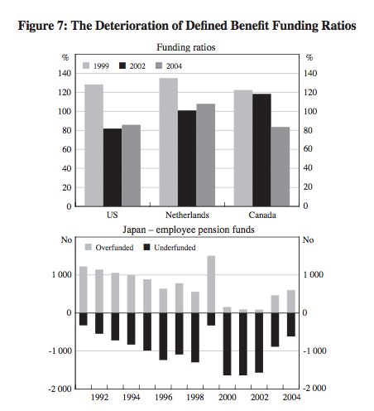
Financial challenges
1. Increasing and improving retirement saving
Pension fund liabilities increase.
Pension funds have become underfunded
Defined Benefit Plans are affected through lower equity market returns and lower interest rates.
Transition from DBP to Defined Contribution Plan, with lower replacement rates and participation → directly affect the savings.
Households are undersaving or are at risk of having inadequate retirement income → Mostly, the middle-income class.

Slide 6
Financial challenges
2. Managing Long-term financial risks
Households have to face a new variety of risks :
Market risks - Inflation risks - Operational risks - Longevity risks - Health Care risks.
The goal → RECONSIDERATION OF EXISTING RISK-SHARING ARRANGEMENTS
Consequences
More individual decision-making about their own savings and investments
In order to handle the risks, they have to get better investment education by the government
Facts
Transfer of the risks to the households (Shift from DB to DC plan)
More costs regarding health care → Burden for the households and the government

Slide 7
Current efforts
Reforms on public pension and health care systems
Regulatory and supervisory frameworks
Accounting standards
More sustainable
Cut public spendings for health care
More private insurance for health care
More prudential investment approach
Focus on asset-liabilities management and not just on asset returns
Better supervision → risk-based approach
Focus on risk management
Use of IFRS : Fair value → disclosure of the changes (Mark-to-market).
Risk of that approach: short-term perspective

Slide 8
Current efforts
Tax policy
Financial education of households
Use to put upper and lower bounds for funding decisions
Discouraging precautionary overfunding
Give preferential to retirement savings → the tax-favoured vehicles are mostly an incentive to reallocate savings
Improving financial stability
New products that are better-tailored for the saving needs
Motivating households to save more
Communication & education

Slide 9
Role of financial markets
Development of existing markets
New market-oriented instruments.
Risk-based regulatory framework.
Focus on asset-liability management.
Creation of hedging facilities against risks (newly born-risks) for insurance companies → possibility to offer annuities to households.
Increase of annuitization e.g. by investing in bonds.
Access to additional asset classes.
Efforts to develop new markets
Health care coverage and costs: prediction tools are needed.
House price risk: increase households’ ability to hedge price movements.
Market structure and innovation: need of decent legal and institutional frameworks that give room for innovation.

Slide 10
The government as risk manager
Encouraging the private sector to address incomplete markets
Stimulate the creation of new products that are more simple for the households.
Accounting changes to provide more useful information for investors.
Providing tax incentives for long term saving.
Compulsory rules e.g. health care coverage.
Being the insurer of last resort
Providing solutions when markets are unable.
Acquire a portion of longevity exposure.
Government actions should be part of a comprehensive strategy.

Slide 11
Conclusion
Ageing Population
Greater attention regarding the macroeconomic & financial stability
Pension funds
Weak financial position → Better risk-management to meet long-term obligations
Households
Measures to ensure the ability to manage the new risks
Government
New framework & new risk-sharing arrangements

Slide 12
What is the dependency ratio and what are the trends influencing it?
Why and how can the government become the insurer of last resort? Explain.
What are the implications of the shift from a DB plan to a DC plan for the households? How can the government improve the situation?
Questions

Slide 13
Any questions?
Thanks for your attention

